Slide 1


WELCOME TO GOA
FOR
7TH ANNUAL GENERAL MEETING
27th JULY 2024 ( SATURDAY)
TAN N SAND BEACH RESORT, GOA

Slide 2


Slide 3

7th AGM

Slide 4


Slide 5


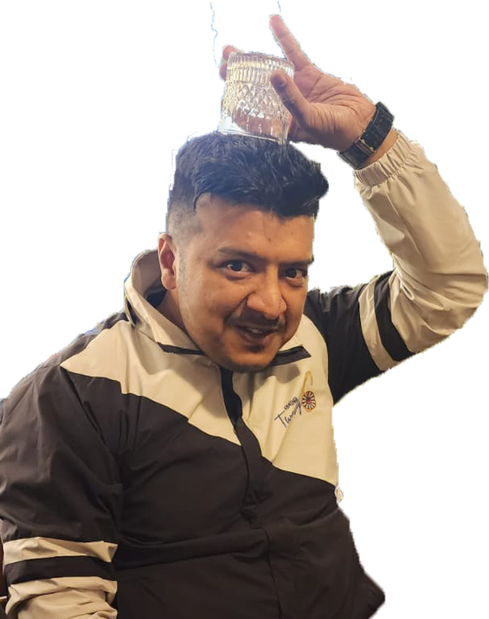
MEETING CALL TO ORDER
7th AGM
Tr.Sankey Agrawal Chairman (2023-2024)

Slide 6

TOAST TO SPONSOR TABLE
7th AGM

Slide 7
MEETING CONVENING NOTICE
Notice is hereby given that DRT26 will be having its 7TH AGM for the year 2023-24 on 27th July, 2024 at Tan N Sand Beach Resort, Goa at 3;00 PM.
7th AGM
Tr.Prashant Agrawal
Secretary (2023-2024)

Slide 8

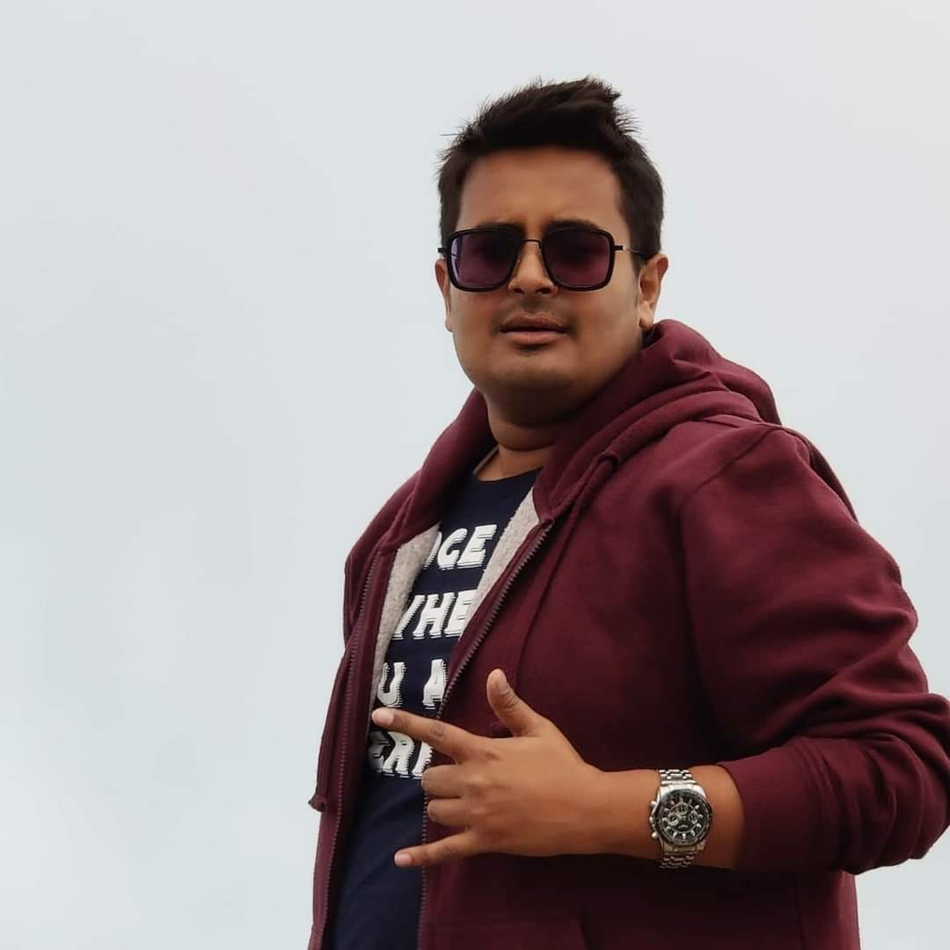
AIMS & OBJECTIVES
a) To develop the fellowship of young men through the medium of their business and professional occupations and community service activities.
b) To encourage active and responsible citizenship by cultivating the highest ideals in business, professional and civic traditions.
c) To promote and further international understanding, friendship and co-opera`tion.
d) To promote the extension of the association.
7th AGM
Tr.Pankaj Agrawal

Slide 9


RTN SONG
If we could consider each other. A neighbour, a friend or a brother
It would be a wonderful, wonderful world, it would be a wonderful world
If each little kid had fresh milk each day, if each old soul had some place to stay
If each working man had enough time to play, it would be a wonderful world
Cc cc Chorus cc cc
If there was no poor and rich were content , if strangers were welcome wherever they went
If each of us knew what true brotherhood meant, it would be a wonderful world
Cc cc Chorus cc cc
If people all over the world trust one another, not thinking about their race of their color
If they did agree to join hands altogether, it would be a wonderful world
Cc cc Chorus cc cc
If tabler of Nepal can properly plan. To do for their country whatever they can
If FELLOWSHIP brings about SERVICE to man, it would be a wonderful world
Cc cc Chorus cc cc
Oh boy! it would be a wonderful world
7th AGM
Notes:
RTN SONG

